Slide 1
Civil air patrol
Created by C/CMSgt Bob Aubrey
June 2014
The purpose of this PowerPoint is to give cadets knowledge that will be of valuable use in both C.A.P. and their lives out side of C.A.P. Cadets will learn Leadership skills, moral values, the meaning of our Core Values, C.A.P.’s missions, and other valuable information. This PowerPoint was created for Worcester Cadet Squadron NER-MA-022.
Created using Microsoft PowerPoint 2007. Viewing this PowerPoint with other software may display the PowerPoint improperly.

Slide 2
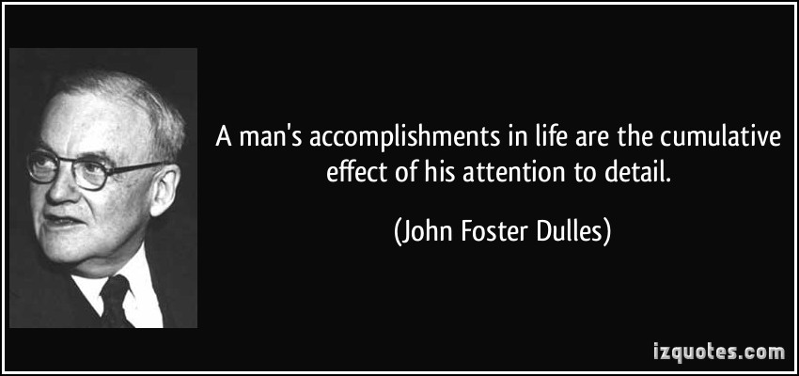
Attention to Detail
Attention to detail is paying attention to the smallest details of things so they do not get overlooked.
It is important to pay attention to detail right now. Pay attention to detail to everything this PowerPoint has to offer. You’ll learn things from this that can help you in both C.A.P. and in other situations in your life. Another thing where paying attention to detail is important is learning everything you can from your Learn to Lead leadership books. Knowing a lot of information from these books will surely give you an advantage not only in C.A.P. but in your daily life.
Put all your focus solely on this PowerPoint and refrain from thinking about anything or doing anything that would cause learning to be less effective.

Slide 3
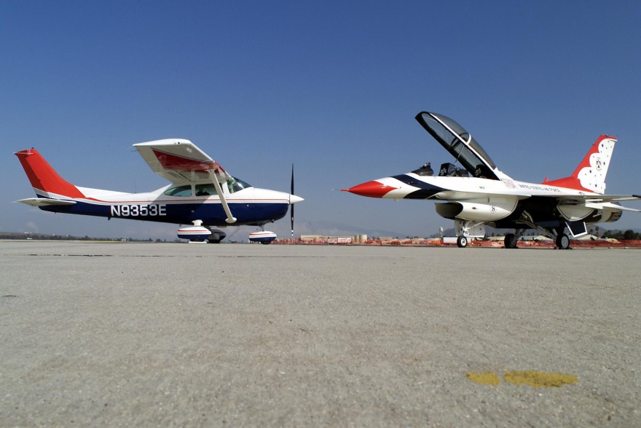
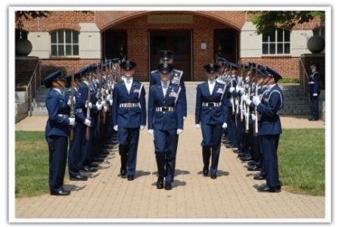
What C.A.P. is
According to Wikipedia, Civil Air Patrol (CAP) is a Congressionally chartered, federally supported non-profit corporation that serves as the official civilian auxiliary of the United States Air Force (USAF). CAP is a volunteer organization with an aviation-minded membership that includes people from all backgrounds, lifestyles, and occupations. It performs three congressionally assigned key missions: emergency services, which includes search and rescue (by air and ground) and disaster relief operations; aerospace education for youth and the general public; and cadet programs for teenage youth. In addition, CAP has recently been tasked with homeland security and courier service missions. CAP also performs non-auxiliary missions for various governmental and private agencies, such as local law enforcement and the American Red Cross. The program is established as an organization by Title 10 of the United States Code and its purposes defined by Title 36

Slide 4
The Purpose of C.A.P.
36 U.S. Code § 40302
The purposes of the corporation are as follows:
(1)To provide an organization to—(A)encourage and aid citizens of the United States in contributing their efforts, services, and resources in developing aviation and in maintaining air supremacy; and
(B)encourage and develop by example the voluntary contribution of private citizens to the public welfare.
(2)To provide aviation education and training especially to its senior and cadet members.
(3)To encourage and foster civil aviation in local communities.
(4)To provide an organization of private citizens with adequate facilities to assist in meeting local and national emergencies.
(5)To assist the Department of the Air Force in fulfilling its noncombat programs and missions.

Slide 5
Our Core Values
As a Civil Air Patrol Cadet of Worcester Cadet Squadron, you are responsible for learning the meaning of the Core Values, and implementing then not only at C.A.P. activities, but also in your daily lifestyle.
Integrity: Doing the right thing even when no one is looking.
Integrity, our first core value needed if we are to uphold the value of the others. Doing good things in life, especially things that help the well being of others can have give yourself a positive image, and also C.A.P. a positive image if they know you are in the program. Doing wrong can have the opposite effect.
Volunteer Service: Doing things that help others without making profit.
It is part of what C.A.P. is all about. Volunteer service includes being a leader helping others reach their potential so that they too can better their community, cleaning a part of a community, doing search and rescue (S.A.R.) missions to save lives, and participating in C.A.P.’s Drug Demand Reduction program. Helping our community voluntarily can make it better for others.
Excellence: Giving your best effort to accomplish something.
Every C.A.P. cadet is expected to give their best effort in P.T., living up to our core values, accomplishing tasks and missions, and anything that requires excellence outside of C.A.P. If everyone gives their best efforts, it will make this Squadron much better.
Respect: A feeling of admiration for someone because of their abilities, qualities, or achievements.
We all have our unique differences both mentally and physically. Showing respect to others is something that you will do.

Slide 6
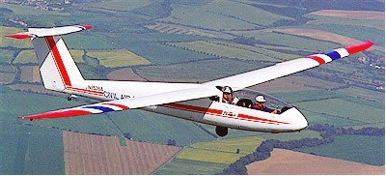
Our Missions
Civil Air patrol has three main missions: Aerospace Education, Emergency Services, and Cadet Programs. Familiarizing yourself with the purpose of each mission will help you better understand what C.A.P. wants for its cadets.
Aerospace Education: One of our missions is to educate ourselves in Aerospace. Aerospace Modules, Orientation Flights, and extra knowledge we gain outside of C.A.P. are part of this.
As part of advancing your knowledge in aerospace, you’ll have the opportunity to fly in C.A.P. Powered and Glider aircraft for 10 flights (5 Powered, 5 Glider). You’ll be able to get a scenic view of your area and surrounding areas. In powered aircraft, your pilot will let you fly the plane from the co-pilots seat and allow you to practice turns, stalls, ascents and descents at the price of $0.00!
Picture taken by Capt Patrick Bucklin
Worcester Cadet Squadron NER-MA-022

Slide 7
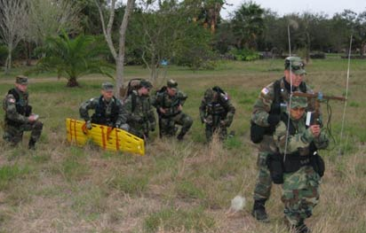
Our Missions
Emergency Services: Thanks to the members who put an immense amount of dedication into training for ES, Civil Air Patrol’s Emergency Services program saves many lives every year from things including natural disasters and being stranded in an isolated environment.
Most Cadet and Composite Civil Air Patrol units conduct Search And Rescue Exercises (SAREXs) which can be learning how to use a map and compass, working as a team to find someone stranded in the woods, training for searching for Emergency Locating Transmitters (ELTs), and using C.A.P. aircraft to train for searching for missing people.
C.A.P. operates thousands of aircraft nationwide to assist in Emergency Services.

Slide 8
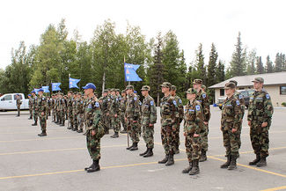
Our Missions
Cadet Programs: Civil Air Patrol offers a variety of things for cadets, including Squadron meetings that dedicate to developing its cadets’ character, Week long encampments, Orientation Flights, having cadet leaders have a strong influence over the unit, etc. To accomplish this mission, every cadet should be active in, and have motivation to commit to cadet programs.

Slide 9
The New Cadet
Every new cadet in C.A.P. starts at the grade of Cadet Airman Basic (C/AB). The new cadet’s expectation is to learn the basics of C.A.P.: How it’s run, it’s purposes, what it’s benefits are, proper behavior for CAP meetings, and many other things. That cadet needs to find out if the program is right for them before he/she makes a long term commitment to staying in the program. The cadet should not make this decision too quick. They may not like it the first few meetings, but may begin to like it after a while one they learn what C.A.P. has to offer. As mentioned in Learn to Lead, one of the main responsibilities of a new cadet is to develop themselves to be a good follower, so that they may be a good leader.
Some good tips for new cadets:
1. Try not to be shy. Be actively engaged in C.A.P. activities to get a better benefit from the program.
2. Learn what your leaders want from you if you decide to stay in the program.
3. The stuff you learn in C.A.P. is most likely completely different than what you are used to. This may cause a lack of confidence in whether the Leadership skills and values C.A.P. teaches will work for you. If you are this type of person, it is important to give yourself purpose and motivation for accepting what C.A.P. teaches.

Slide 10
Promotions
It is every cadets responsibility to get promoted on a regular basis. Cadet leaders also have responsibility for motivating their fellow cadets to get promoted. Cadets can advance in rank once every 2 months or more. Junior Reserve Officer Training Corps. (J.R.O.T.C.) cadets are eligible to promote faster based on the time they spent in that program. Getting promoted to the next grade can involve taking a test on Learn to Lead, a test on one of the six Aerospace modules of the cadet’s choice, a Physical Training test, and a Review Board. Learn to Lead and Aerospace tests can either be taken online, or at the Squadron meetings (paper test).
To get promoted to:
C/Amn: 1. Take the Learn to Lead Ch. 1 test
2. Take a P.T. Test
3. Review Board
4. There is no Aerospace Test
C/A1C: 1. Take the Learn to lead Ch. 2 test
2. Take a P.T. Test
3. Review Board
4. Aerospace test
Note: Remember that getting a promotion is not all about getting an extra chevron on your collar. As you progress through the program, your leaders will set higher expectations upon you. You are expected to use the leadership skills you learned in Learn to Lead and apply them to real world situations. Look back at the materials you’ve studied periodically so you don’t forget them.

Slide 11
Promotions
The following will be used in review boards for determining if cadets trying to promote to E-2 to E-5 will be allowed to advance in grade. This has been taken from the Cadet Super Chart.
Attitude: Displays a positive attitude; optimistic; enthusiastic; is team oriented.
Core Values: Aware of the Core Values; honest; wears uniform properly; practices customs and courtesies
Communication Skills: Listens actively; attentive; asks good questions
Sense of Responsibility: Follows directions; dependable; arrives ready to learn and serve; effective in managing own time

Slide 12
Team Work
C.A.P. is a team oriented organization. When you are attending any C.A.P. activity you are part of a team. It is important to build trust in one another as it manifests into confidence in working together. Working together gives you the opportunity to gain experience with other individuals.
Remember that everyone has different personalities, that’s one of the things that makes humans unique. Due to this, people will agree and disagree with each other on certain topics. It is important to not let a disagreement manifest into a conflict that will deteriorate the structure of a team.
Through the use of team work, C.A.P. cadets will get to know the strengths and weaknesses of others and themselves.
It is the responsibility of everyone involved to keep the team structure and integrity secure.
Every C.A.P. cadet will be treated as part of a team.

Slide 13
Navy SEAL Self-Confidence Video
Former Navy SEAL, and top motivational speaker David B. Rutherford explains his motivational training program. The Froglogic Concept is a two part program to help forge an individual's Self-Confidence and inspire him or her to live a team orientated lifestyle. If the video doesn’t load: https://www.youtube.com/watch?v=r_dtRIf0rGY
His missions for developing Self-Confidence: Positive Attitude, PT and be Healthy, Motivation, Earn Respect, Set Goals, Integrity, Mentoring, Have Fun

Slide 14
Selfishness and Selflessness
Selfishness: Doing what is good just for yourself and not for others. In a team environment. Selfishness is discouraged by many, as it goes against the purposes of team work. However, selfishness is heavily prevalent in today's society, and is seen in action everywhere. Selfishness can include: Taking more than giving when others don’t appreciate you doing that, not willing to share equally.
Selflessness: The opposite of selfishness. To be selfless means putting your teams goals, comforts, and desires ahead of your own. It can also be giving more than you take to help other people. In C.A.P., selflessness is essential, because you are part of a team all trying to accomplish a common set of goals. In this kind of setting, having the will to give a lot can be the difference of whether that team accomplishes those goals or not.
Example: Take two cadets waking up at Encampment early enough that the sun is barely visible on the horizon. A Selfish cadet will be focused on his own pain. He will probably lack regard for working as a team as he worries about his tiredness. He probably won’t want to run because his shoes hurt, and many other senseless things that go against etiquettes of teamwork. The Selfless cadet, despite realizing how tired he is from waking up that early, will keep in mind that there are other people tired. There are other people in uncomfortable situations that are part of his/her team. Selfless people will push through the hardship and not let it effect the team’s efficiency at accomplishing a task or a mission.

Slide 15
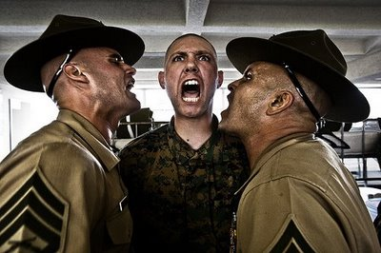
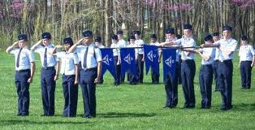
Discipline
It’s one thing that many leaders in C.A.P. like to enforce. Having discipline means being able to follow a set of rules and expectations that are placed on yourself. It could be you are trying to get up in the morning at 0600 for school, or being able to resist pulling out your phone in class for something that is not related to school. Having discipline means having good self control.
Having a team that is highly disciplined can be very valuable to a situation that highly depends on it. One example is ground handling a glider airplane. If the team is trying to remove a glider from a hangar, and they did not have the discipline to pay attention to ground handling videos and instructions given to them, it could end up costing you $$$. Discipline is important in many areas of life.
Having a disciplined and orderly lifestyle can also bring a sensation of pride.
For the new cadets: Don’t worry, enforcement of self-discipline is not conducted in this manner at C.A.P.
Drill and Ceremonies requires the cadet to have both a strong level of self-discipline and attention to detail in order for the team to accomplish good overall Drill and Ceremonies.

Slide 16
The Uniforms of C.A.P.
The Battle Dress Uniform (BDU) and Air Force Blues are the primary uniforms worn by C.A.P. members. C.A.P. also has other uniforms such as the Blue BDU, Mess Dress
Your uniform is not just something you wear to a meeting to for everyone to look the same. Your uniform represents Civil Air Patrol and everything that the program stands for. It also represents those who wore it both past and present. Because of that, I expect all of you to wear the uniform with pride.
In Worcester Cadet Squadron the expectation for uniform wear is: Make sure it is fully ironed (do not iron the AF Blues pants). The rank insignia is 1 inch from the edge of the collar, no more than 1/8 inch in deviation and parallel with the edge. Your boots will be shined to a high gloss.
Remember that the AF Blues pants, Flight Cap, and Service coat are DRY CLEAN ONLY. The light blue blues shirts can be machine washed.

Slide 17
Physical Training (PT)
Physical Training (PT) is held at C.A.P. meetings occasionally. Every cadet will participate in Physical Training unless they have a doctor’s note that specifies they are physically unsuitable to do certain or all Physical Activities. PT will include stretches, push-ups, sit-ups, 1+ mile run, shuttle run, and other things that you’ll find out soon. It is important as a C.A.P. cadet that you live a healthy lifestyle, and doing PT promotes that.
Remember that Physical Training is not done at just C.A.P. meetings. You are responsible for developing your physical strength outside of C.A.P. as well.

Slide 18
Drill and Ceremonies
Drill, either by a formation of cadets or a Color Guard, shows pride to one’s organization. It may not seem like that big of a deal to new cadets when they are practicing at the base, but when you march in a parade with hundreds or even thousands of people looking at you and your group all marching in step and looking straight forward, you and the audience will feel a sensation of pride. Drill and Ceremonies has been a long time military tradition. As the auxiliary of the U.S. Air Force, we practice that tradition as well. Things Drill and Ceremonies does for the individual and the team:
Discipline: When you are a part of a Drill team or Color guard, you are required to do many things that will test the limits of your temptations. For Example: you may need to stand at Parade Rest for 10 minutes. This involves keeping your eyes straight forward the whole time, and not moving at all. Defying these rules will result in punishment. D&C teaches cadets to follow and obey orders sharply and consistently.
Pride: Marching in a parade correctly with discipline will surely give former and active military members a sense of pride that there are youth motivated to follow in their foot steps. You will probably also be proud of yourself and your team for making your unit look good and squared away.
Team Work: Drill and Ceremonies helps put an emphasis on the importance of teamwork. Everyone in a Drill Team or a Color guard must work together to ensure that they are on the right step, and their proper intervals are established and maintained. If one person is off on one of these things, it can make the whole team look bad.

Slide 19
Meeting Types and Procedures
How it works: The following are formats each meeting may be set up to by the Squadron Commander. The Cadet Commander and appropriate staff can recommend to the Squadron Commander a type of meeting to be held. The Squadron Commander can also decide to mix meeting types. For example: The Commander can decide to have a meeting of Drill and Ceremonies/SAREX. All types will have: (a) An opening formation at the beginning, and a closing formation at the end of the meeting. (b) Uniform inspection (except: when CIVs are worn, and when appropriate, Ceremonial Night). (c) All meetings and CAP events held will hold strict adherence to CAP’s Core Values and principles. (d) Be carried out based on an organized schedule. (e) All meeting types will be carried out with everyone displaying a high level of discipline. There will not be any fooling around or disorderly conduct. You are part of a paramilitary organization and are expected to live life setting a good example as a CAP cadet for others to see. You come to the meeting, learn how to better yourself and your team, and then go home proud. Questions and Suggestions should be taken up the Chain of Command.
Standard Night: Uniform BDUs/PTU. This type of meeting may have a combination of Physical Training (PT), drill and ceremonies, and also may include Safety briefings and Character Development. This type of meeting is modeled primarily after meetings we usually have done in the past. For the main difference, refer to section “e” of the first paragraph.
Hell Night: Uniform: BDUs/PTU. The toughest type of meeting we have to offer. It’s a challenge that fits the saying “a few hours of pain for a few days of pride”. Throughout the meeting, cadets will instill discipline, learn leadership skills quickly, will have their leadership skills tested under stressful conditions, build physical and mental toughness, learn how to stay calm under stressful conditions, build teamwork, and give the cadet an idea of how a CAP Encampment is run. It’s a meeting that will make cadets quickly realize that it is imperative to learn that trust in one another and teamwork are vital keys to the success of our Squadron. Most of the meeting (including PT) will be conducted in BDUs. The meeting will consist of mostly PT, with Drill and Ceremonies being used to teach discipline, teamwork, and leadership lessons, and SAREX. During D&C, cadets will be asked questions regarding what they’ve learned in the Learn to Lead and Aerospace books they’ve studied. If they answer them wrong, they will be disciplined (you’ll find out how). All cadets being trained will be yelled at as a group, so don’t take it personal.

Slide 20
Meeting Types and Procedures
SAREX Night: Uniform BDUs. A meeting dedicated to doing Search and Rescue Exercises, this meeting will almost always be held outside during Spring and Summer. In Fall and Winter, when the temperature is a danger, SAREX meetings will be required to be held inside. Cadets will be given a series of tasks, and will be trained and expected to carry them out effectively as a team under stressful conditions. SAREX involves searching for a person in the woods by doing search patterns, learning how to help an injured person, carrying someone back to base by stretcher or fireman’s carry, and learning how to use a map and compass. The difference that SAREX activities have in this Squadron now compared to SAREX activities we done before this document took effect is that they will have no relation to a Special Activities Night. They will be carried out in a serious and productive manner.
Special Activities Night: Uniform BDUs/PTU/CIV. It’s a night dedicated to doing activities that are rewarding for cadets’ hard work and accomplishments. The primary goal of this meeting is to have fun. Activities in this meeting may include rappelling, Combat Training, sports, Shooting range, watching movies, etc. For this type of meeting to occur, the Squadron Commander, Cadet Commander, and Staff must determine if everyone has done enough work to deserve one. This meeting will be designed to be a morale booster and a team building exercise. All cadets attending a Special Activities night must have attended at least one Hell Night since the last Special Activities Night, and be in good standing.
Drill and Ceremonies Night: Uniform Blues. A meeting dedicated to Drill and Ceremonies. This meeting includes teaching Drill and Ceremonies individually, as elements, as flights, or as a Squadron depending on the cadets’ knowledge in D&C. This type of meeting will occur to train for an upcoming parade and/or if our performance in Drill is unsatisfactory.
Character Development Night: Uniform Blues. This meeting can consist of teaching: Leadership skills, the fundamentals of CAP, Current Events, CAP News, life lessons, introduction to CAP for new members, and anything else that relates to these. Since meetings are 2 ½ hours long, this type of meeting is recommended to be combined with another such as Drill and Ceremonies night. If it is combined with a meeting type that is not Blues, the uniform of the other type of meeting will be worn instead of Blues.
Ceremonial Night: Uniform Blues. This meeting will usually be for awards and/or celebration, such as a Change of Command ceremony, Christmas party, etc. All members of the Squadron will be given at least a one week notice.

Slide 21
Notes
Keep the these words and their meanings in mind:
Motivation: An emotion that gives the person desire to do something.
Dedication: When one is tenaciously involved with something, and allocates a lot of resources for.
Inspiration: A process of being mentally exhilarated to do something
Confidence: Having faith that someone or something will work accordingly to plan
Commitment: The state of being dedicated for something
Self-Awareness: conscious knowledge of one's own character, feelings, motives, and desires

